Slide 1
NEURAL NETWORK
Prepared by:
KEJI, Adebayo Adebayo

Slide 2
CONTENTS
Introduction
Installation
Preliminaries
Road to deep learning
Linear Neural Networks
Multilayer Neural Network
Deep Learning Computation
Convolutional Neural Network

Slide 3

Introduction
Imagine just writing a program to respond to a wake word such as “Alexa”, “OK Google”, and “Hey Siri”. Try coding it up in a room by yourself with a computer and a code editor, as illustrated in the figure below. How would you write such a program from first principles?
even if you do not know how to program a computer to recognize the word “Alexa”, you yourself are able to recognize it. Armed with this ability, we can collect a huge dataset containing examples of audio and label those that do and that do not contain the wake word.
we define a flexible program whose behavior is determined by a number of parameters. Then we use the dataset to determine the best possible set of parameters, those that improve the performance of our program with respect to some measure of performance on the task of interest. You can think of the parameters as knobs that we can turn, manipulating the behavior of the program. Fixing the parameters, we call the program a model
And the meta-program that uses our dataset to choose the parameters is called a learning algorithm.

Slide 4


Installation
Download and Install Anaconda
Launch Jupyter Notebook
Install packages through Anaconda prompt

Slide 5
Preliminaries
This sort of problem, where we try to predict a designated unknown label based on known inputs given a dataset consisting of examples for which the labels are known, is called supervised learning.
no matter what kind of machine learning problem we take on:
1. The data that we can learn from.
2. A model of how to transform the data.
3. An objective function that quantifies how well (or badly) the model is doing. (Loss Function)
4. An algorithm to adjust the modelʼs parameters to optimize the objective function: Popular optimization algorithms for deep learning are based on an approach called gradient descent.

Slide 6
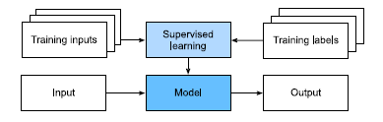
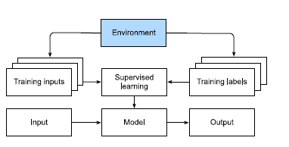
Con’t
Kinds of Machine Learning Problems
Supervised Learning: Regression, Classification, Tagging : Our goal is to produce a model that maps any input to a label prediction.
Unsupervised and Self-Supervised Learning: e.g Generative Adversarial Network The boss might just hand you a giant dump of data and tell you to do some data science with it! This sounds vague because it is. We call this class of problems unsupervised learning, and the type and number of questions we could ask is limited only by our creativity
Reinforcement Learning in which an agent interacts with an environment over a series of time steps. At each time step, the agent receives some observation from the environment and must choose an action that is subsequently transmitted back to the environment via some mechanism (sometimes called an actuator).

Slide 7
Road to Deep Learning
machine learning can use data to learn transformations between inputs and outputs, such as transforming audio into text in speech recognition. In doing so, it is often necessary to represent data in a way suitable for algorithms to transform such representations into the output.
Deep learning is deep in precisely the sense that its models learn many layers of transformations, where each layer offers the representation at one level. For example, layers near the input may represent low-level details of the data, while layers closer to the classification output may represent more abstract concepts used for discrimination

Slide 8
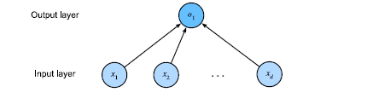
LET GET STARTED…………….
These diagrams highlight the connectivity pattern such as how each input is connected to the output, but not the values taken by the weights or biases.
For the neural network shown above the inputs are x1; : : : ; xd, so the number of inputs (or feature dimensionality) in the input layer is d. The output of the network in the figure above is 1, so the number of outputs in the output layer is 1. Note that the input values are all given and there is just a single computed neuron, conventionally, we do not consider the input layer when counting layers. That is to say, the number of layers for the neural network above 1.

Slide 9
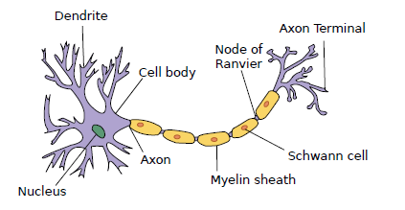
Biology
In the picture of a biological neuron below, consisting of dendrites (input terminals), the nucleus (CPU), the axon (output wire), and the axon terminals (output terminals), enabling connections to other neurons via synapses.
Information xi arriving from other neurons (or environmental sensors such as the retina) is received in the dendrites.
The weighted inputs arriving from multiple sources are aggregated in the nucleus as a weighted sum and this information is then sent for further processing in the axon y, typically after some nonlinear processing via (y).

Slide 10
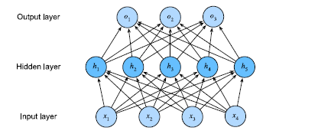
Multilayer Perceptron
we will introduce the first truly deep network.
The simplest deep networks are called multilayer perceptrons, and they consist of multiple layers of neurons each fully connected to those in the layer below (from which they receive input) and those above (which they, in turn,influence).
Regularization techniques: used to combat overfitting, underfitting, and model selection.
weight decay
dropout.
This MLP has 4 inputs, 3 outputs, and its hidden layer contains 5 hidden units.
the number of layers in this MLP is 2.

Slide 11
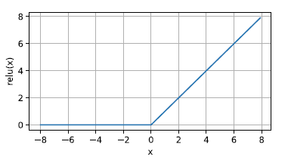
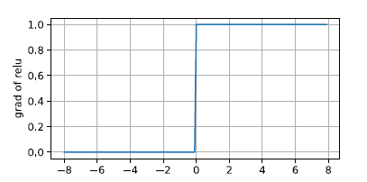
Activation Function
Activation functions decide whether a neuron should be activated or not by calculating the weighted sum and further adding bias with it.
ReLU Function
The most popular choice, due to both simplicity of implementation and its good performance on a variety of predictive tasks, is the rectified linear unit (ReLU). ReLU provides a very simple nonlinear transformation. Given an element x, the function is defined as the maximum of that element and 0:
ReLU(x) = max(x; 0):
When the input is negative, the derivative of the ReLU function is 0, and when the input is positive, the derivative of the ReLU function is 1.
This makes optimization better behaved and it mitigated the well-documented problem of vanishing gradients that plagued previous versions of neural networks

Slide 12
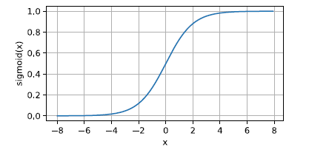
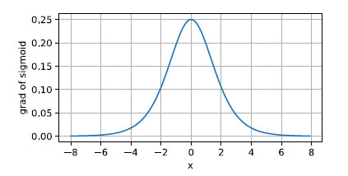
Con’t
Sigmoid Function
The sigmoid function transforms its inputs, for which values lie in the domain R, to outputs that lie
on the interval (0, 1). For that reason, the sigmoid is often called a squashing function: it squashes
any input in the range (-inf, inf) to some value in the range (0, 1):
sigmoid(x) =1/(1 + exp(-x)

Slide 13
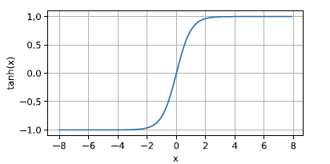
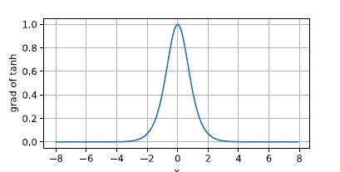
Con’t
Tanh Function
Like the sigmoid function, the tanh (hyperbolic tangent) function also squashes its inputs, transforming them into elements on the interval between -1 and 1:
tanh(x) =1 – exp(-2x)/(1 + exp(-2x)

Slide 14
Softmax operation &Loss Function
Softmax to transform our logits such that they become nonnegative and sum to 1, while requiring that the model remains differentiable, we first exponentiate each logit (ensuring non-negativity) and then divide by their sum (ensuring that they sum to 1)
Loss function is used to measure the quality of our predicted probabilities.
Mean Squared Error (MSE) A problem where you predict a real-value quantity. (Regression problem)
cross-entropy loss is one of the most commonly used losses for classification problems.

Slide 15
Model Selection, Underfitting, and Overfitting
In machine learning, we usually select our final model after evaluating several candidate models. This process is called model selection.
First, we want to watch out for cases when our training error and validation error are both substantial but there is a little gap between them.
If the model is unable to reduce the training error, that could mean that our model is too simple (i.e., insufficiently expressive) to capture the pattern that we are trying to model.
Moreover, since the generalization gap between our training and validation errors is small, we have reason to believe that we could get away with a more complex model. This phenomenon is known as underfitting.
On the other hand, as we discussed above, we want to watch out for the cases when our training error is significantly lower than our validation error, indicating severe overfitting.
The phenomenon of fitting our training data more closely than we fit the underlying distribution is called overfitting, and the techniques used to combat overfitting are called regularization.
Ultimately, we usually care more about the validation error than about the gap between the training and validation errors.

Slide 16
Forward Propagation and Backward Propagation, and Model training
Forward propagation (or forward pass) refers to the calculation and storage of intermediate variables (including outputs) for a neural network in order from the input layer to the output layer.
Backpropagation refers to the method of calculating the gradient of neural network parameters. In short, the method traverses the network in reverse order, from the output to the input layer, according to the chain rule from calculus.
Model training When training neural networks, forward and backward propagation depend on each other. In particular, for forward propagation, we traverse the computational graph in the direction of dependencies and compute all the variables on its path. These are then used for backpropagation where the compute order on the graph is reversed.

Slide 17
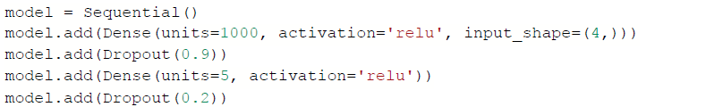
Illustration
Fully connected layer

Slide 18
Thank you

